Slide 1
Estimating the time and height of a meeting of two rockets using barometer and accelerometer measurements. Linear Kalman filter.
Experimental Data Processing
Final Project
Yaroslav Savotin Elizaveta Pestova Selamawit Asfaw

Slide 2
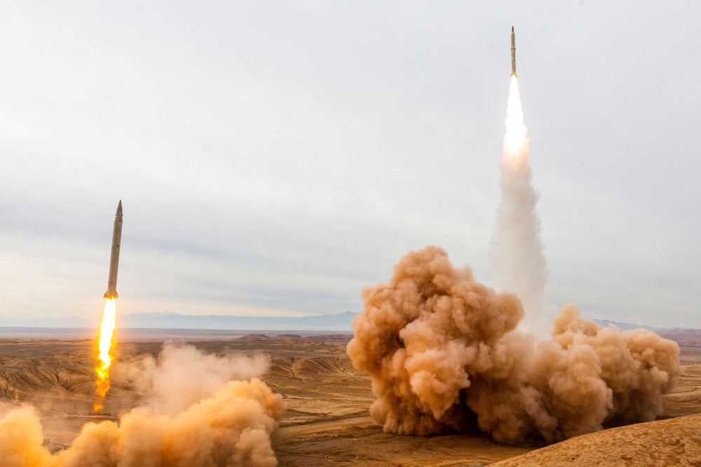
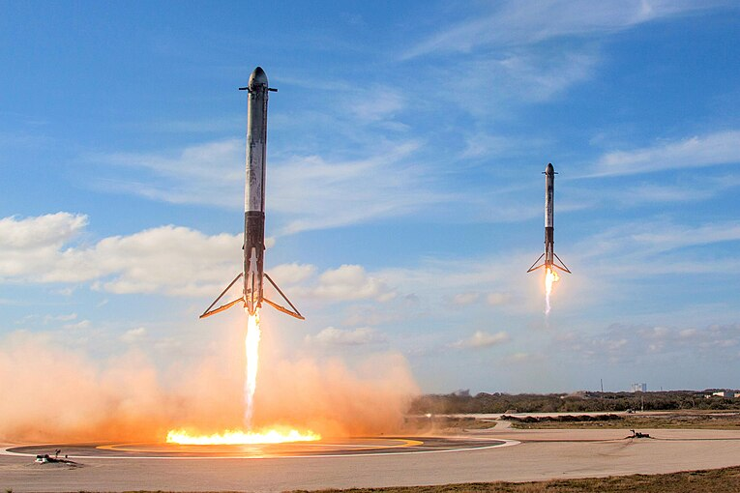
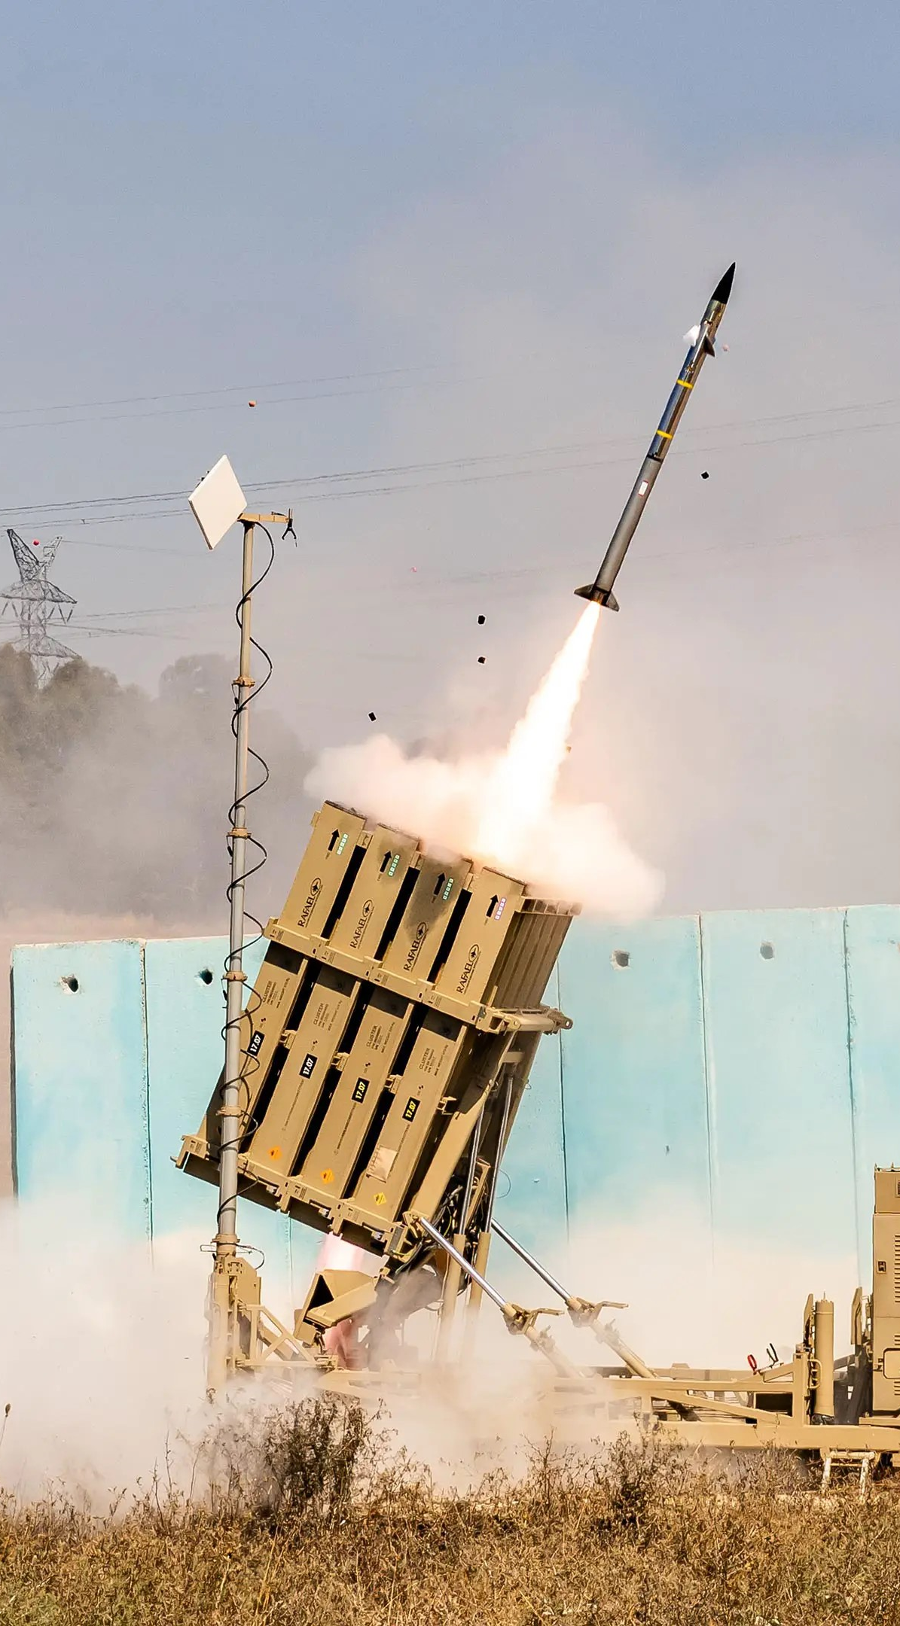
What we are trying to do?
We want to calculate the time and height of a meeting of two rockets based on accelerometer and barometer data.
Why it is significant?
Mission planning of rockets is crucial to prevent collision during space launches and when rocket stages are coming back.
On the other hand, for military purpose, especially air defense, we are interested in precise collision of missiles.

Slide 3
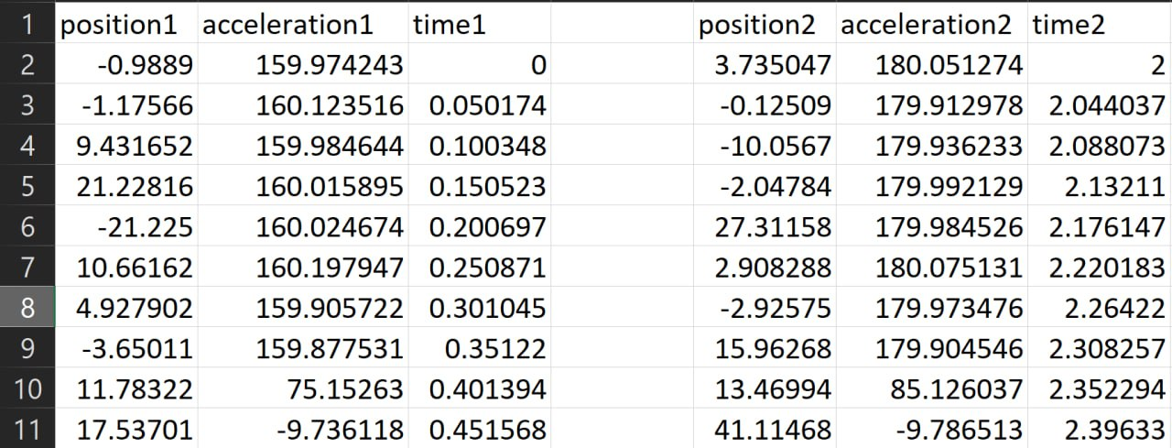
Initial Data we have
To make estimation for height and time of meeting of rockets we use linear Kalman filter because it can give us real time estimation and can be implemented for solving real-world problem.
As initial data we have position and acceleration of two rockets corresponding to the time. Also we have predetermined model of motion and initial conditions (like variances).

Slide 4
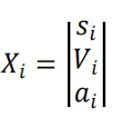
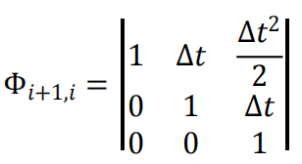
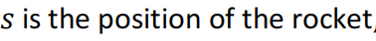
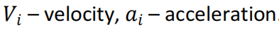
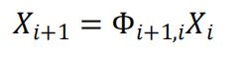
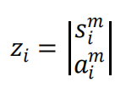
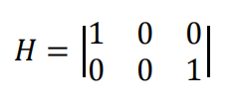
Mathematical Model of our process
State vector
Transition matrix
Observation matrix
Measurement vector
rocket state at step i

Slide 5
Our Methodology to solve this problem
1. We apply forward Kalman filter and backward smoothing.
2. Calculate time and height for both post processed datasets.
3. Compare results of forward backward Kalman filter with smoothing by calculating estimation errors.

Slide 6
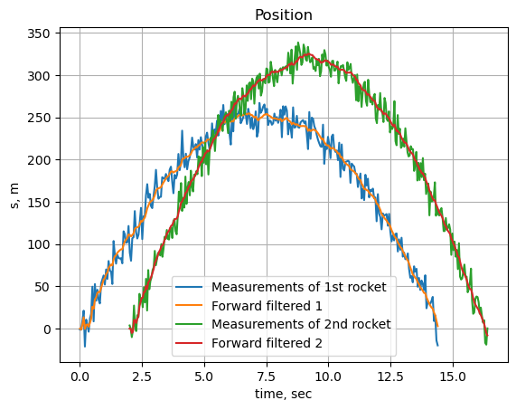
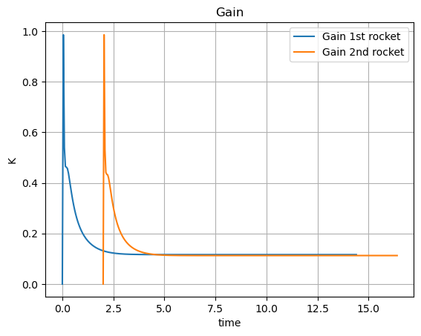
We created two Kalman filters for both rockets:

Slide 7
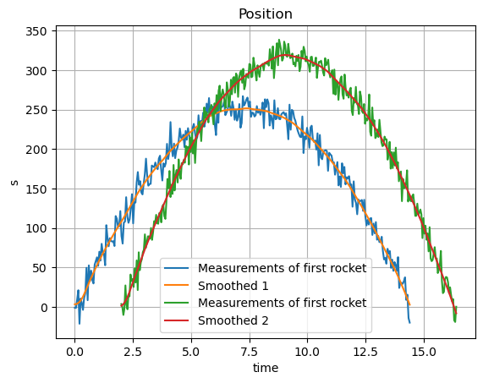
Then we apply smoothing:

Slide 8
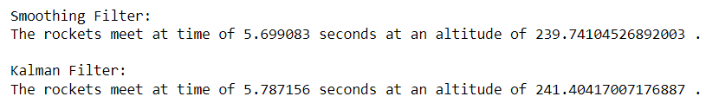
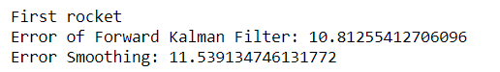
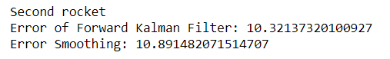
Calculation and comparison of results
For time and height of meeting calculations we get:
For errors calculation we get :

Slide 9
Conclusion:
From both forward Kalman filter and smoothing we are getting pretty similar results for height and time of meeting. However, estimation of accuracy of this methods, we do with the help of true errors which show us that forward smoothing performs better in our case with smaller error for both rockets.
We successfully calculated time and height of two rockets meeting:

